Slide 1
Chapter 6
Normalization of Database Tables

Slide 2
Learning Objectives
After completing this chapter, you will be able to:
Explain normalization and its role in the database design process
Identify and describe each of the normal forms: 1NF, 2NF, 3NF, BCNF, and 4NF
Explain how normal forms can be transformed from lower normal forms to higher normal forms
Apply normalization rules to evaluate and correct table structures
Identify situations that require denormalization to generate information efficiently
Use a data-modeling checklist to check that the ERD meets a set of minimum requirements

Slide 3
Database Tables and Normalization (1 of 2)
Normalization: evaluating and correcting table structures to minimize data redundancies
Reduces data anomalies
Assigns attributes to tables based on determination
Normal forms
First normal form (1NF)
Second normal form (2NF)
Third normal form (3NF)

Slide 4
Database Tables and Normalization (2 of 2)
Structural point of view of normal forms
Higher normal forms are better than lower normal forms
Properly designed 3NF structures meet the requirement of fourth normal form (4NF)
Denormalization: produces a lower normal form
Results in increased performance and greater data redundancy

Slide 5
The Need for Normalization
Used while designing a new database structure
Analyzes the relationship among the attributes within each entity
Determines if the structure can be improved through normalization
Improves the existing data structure and creates an appropriate database design

Slide 6
The Normalization Process (1 of 5)
Objective is to ensure that each table conforms to the concept of well-formed relations
Each table represents a single subject
Each row/column intersection contains only one value and not a group of values
No data item will be unnecessarily stored in more than one table
All nonprime attributes in a table are dependent on the primary key
Each table has no insertion, update, or deletion anomalies

Slide 7
The Normalization Process (2 of 5)
Ensures that all tables are in at least 3NF
Higher forms are not likely to be encountered in business environment
Works one relation at a time
Identifies the dependencies of a relation (table)
Progressively breaks the relation up into a new set of relations

Slide 8
The Normalization Process (3 of 5)
Table 6.2: Normal Forms
Normal Form | Characteristic | Section
First normal form (1NF) | Table format, no repeating groups, and PK identified | 6-3a
Second normal form (2NF) | 1NF and no partial dependencies | 6-3b
Third normal form (3NF) | 2NF and no transitive dependencies | 6-3c
Boyce-Codd normal form (BCNF) | Every determinant is a candidate key (special case of 3NF) | 6-6a
Fourth normal form (4NF) | 3NF and no independent multivalued dependencies | 6-6b

Slide 9
The Normalization Process (4 of 5)
Table 6.3: Functional Dependence Concepts
Concept | Definition
Functional dependence | The attribute B is fully functionally dependent on the attribute A if each value of A determines one and only one value of B. Example: PROJ_NUM S PROJ_NAME (read as PROJ_NUM functionally determines PROJ_NAME) In this case, the attribute PROJ_NUM is known as the determinant attribute, and the attribute PROJ_NAME is known as the dependent attribute.
Functional dependence (generalized definition) | Attribute A determines attribute B (that is, B is functionally dependent on A) if all (generalized definition) of the rows in the table that agree in value for attribute A also agree in value for attribute B.
Fully functional dependence (composite key) | If attribute B is functionally dependent on a composite key A but not on any subset of that composite key, the attribute B is fully functionally dependent on A.

Slide 10
The Normalization Process (5 of 5)
Partial dependency: functional dependence in which the determinant is only part of the primary key
Assumption: one candidate key
Straight forward
Easy to identify
Transitive dependency: attribute is dependent on another attribute that is not part of the primary key
More difficult to identify among a set of data
Occur only when a functional dependence exists among nonprime attributes

Slide 11
Conversion to First Normal Form (1NF) (1 of 3)
Repeating group: group of multiple entries of same type can exist for any single key attribute occurrence
Reduces data redundancies
Three step procedure
Eliminate the repeating groups
Identify the primary key
Identify all dependencies
Dependency diagram: depicts all dependencies found within given table structure
Helps to get an overview of all relationships among table’s attributes
Makes it less likely that an important dependency will be overlooked

Slide 12
Conversion to First Normal Form (1NF) (2 of 3)
1NF describes tabular format in which:
All key attributes are defined
There are no repeating groups in the table
All attributes are dependent on the primary key
All relational tables satisfy 1NF requirements
Some tables contain partial dependencies
Update, insertion, or deletion

Slide 13
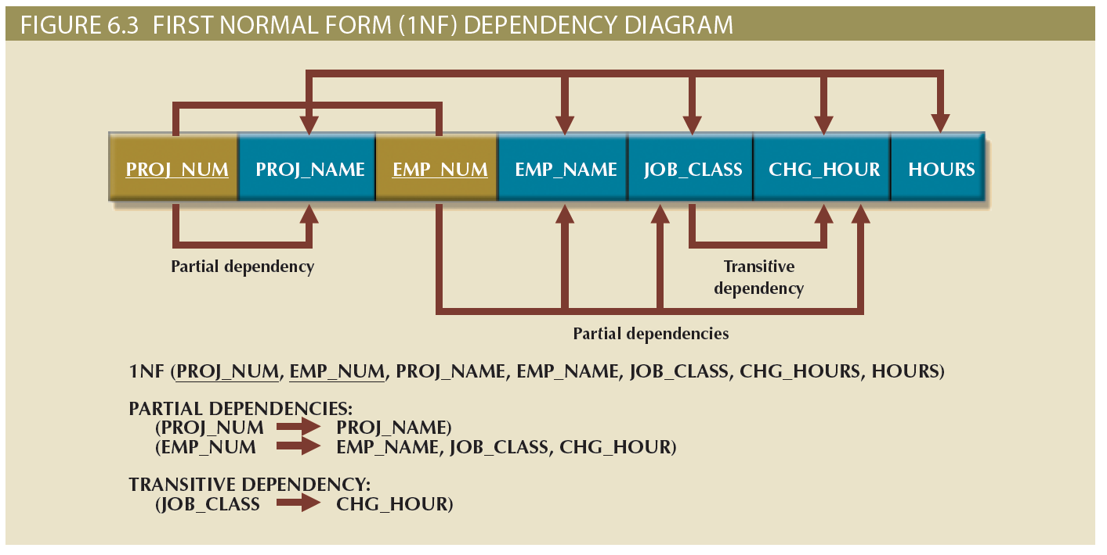
Conversion to First Normal Form (1NF) (3 of 3)

Slide 14
Conversion to Second Normal Form (2NF) (1 of 2)
Conversion to 2NF occurs only when the 1NF has a composite primary key
If the 1NF has a single-attribute primary key, then the table is automatically in 2NF
The 1NF-to-2NF conversion is simple
Make new tables to eliminate partial dependencies
Reassign corresponding dependent attributes
Table is in 2NF when it:
Is in 1NF
Includes no partial dependencies

Slide 15
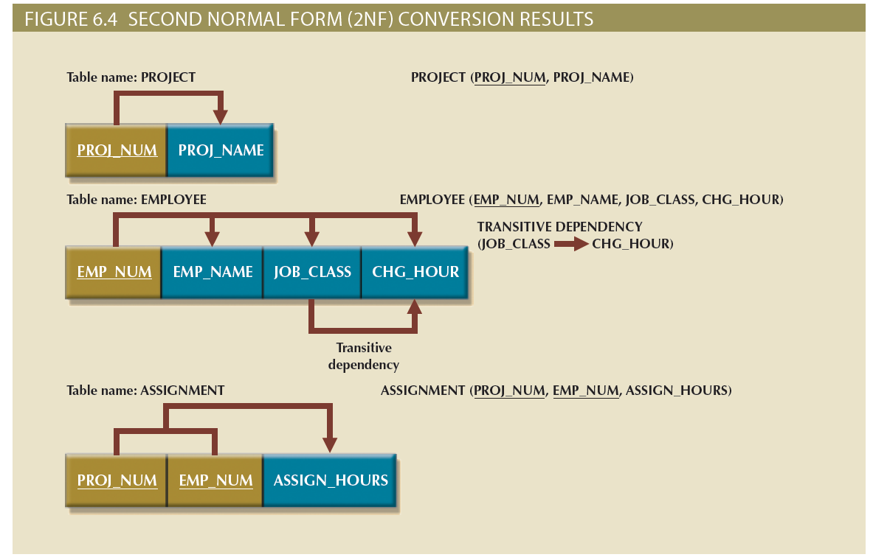
Conversion to Second Normal Form (2NF) (2 of 2)

Slide 16
Conversion to Third Normal Form (3NF) (1 of 2)
The data anomalies created by the database organization shown in Figure 6.4 are easily eliminated
Make new tables to eliminate transitive dependencies
Reassign corresponding dependent attributes
Table is in 3NF when it:
Is in 2NF
Contains no transitive dependencies

Slide 17
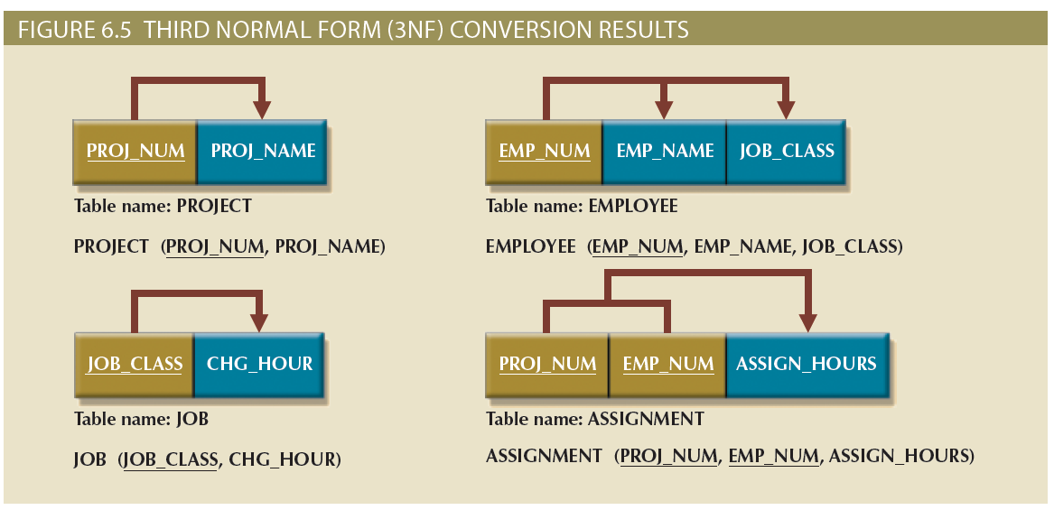
Conversion to Third Normal Form (3NF) (2 of 2)

Slide 18
Improving the Design
Normalization is valuable because its use helps eliminate data redundancies
Evaluate PK assignments and naming conventions
Refine attribute atomicity
Atomic attribute: cannot be further subdivided
Atomicity: characteristic of an atomic attribute
Identify new attributes and new relationships
Refine primary keys as required for data granularity
Granularity: Level of detail represented by the values stored in a table’s row
Maintain historical accuracy and evaluate using derived attributes

Slide 19
Surrogate Key Considerations
Used by designers when the primary key is considered to be unsuitable
System-defined attribute
Created an managed via the DBMS
Have a numeric value which is automatically incremented for each new row

Slide 20
The Boyce-Codd Normal Form (1 of 4)
Every determinant in the table should be a candidate key
Candidate key: same characteristics as primary key but not chosen to be the primary key
Equivalent to 3NF when the table contains only one candidate key
Violated only when the table contains more than one candidate key
Considered to be a special case of 3NF

Slide 21
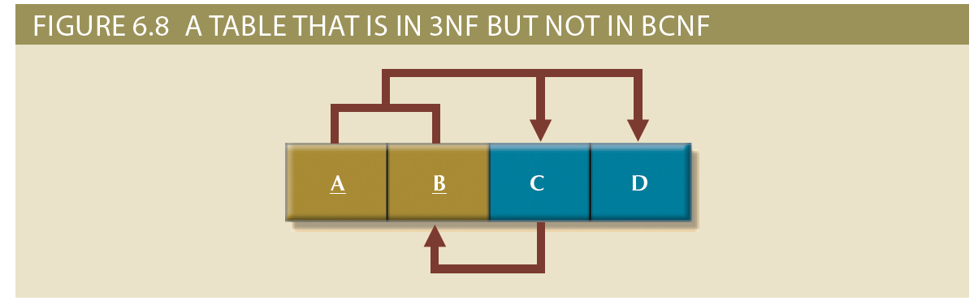
The Boyce-Codd Normal Form (2 of 4)

Slide 22
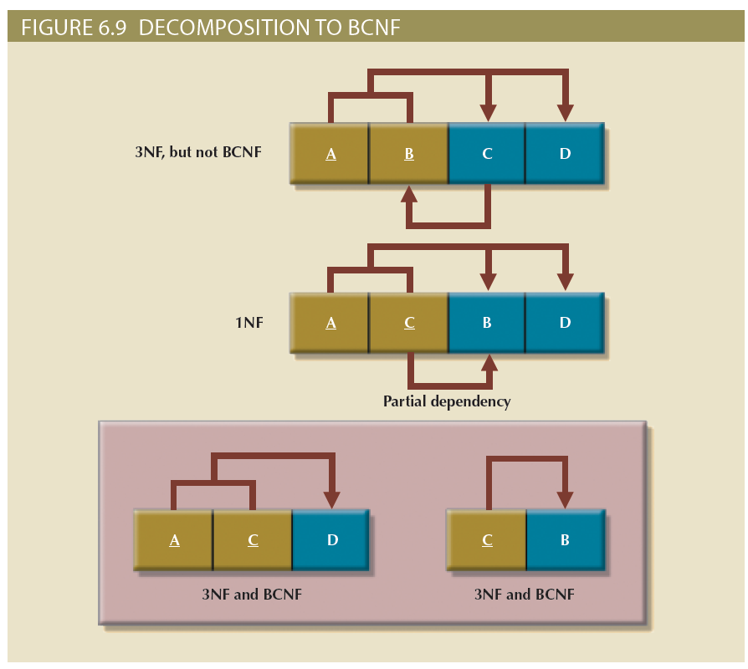
The Boyce-Codd Normal Form (3 of 4)

Slide 23
The Boyce-Codd Normal Form (4 of 4)
Table 6.5: Sample Data for a BCNF Conversion
STU_ID | STAFF_ID | CLASS_CODE | ENROLL_GRADE
125 | 25 | 21334 | A
125 | 20 | 32456 | C
135 | 20 | 28458 | B
144 | 25 | 27563 | C
144 | 20 | 32456 | B

Slide 24
Fourth Normal Form (4NF) (1 of 2)
Rules
All attributes must be dependent on the primary key, but they must be independent of each other
No row may contain two or more multivalued facts about an entity
Table is in 4NF when it:
Is in 3NF
Has no multivalued dependencies

Slide 25
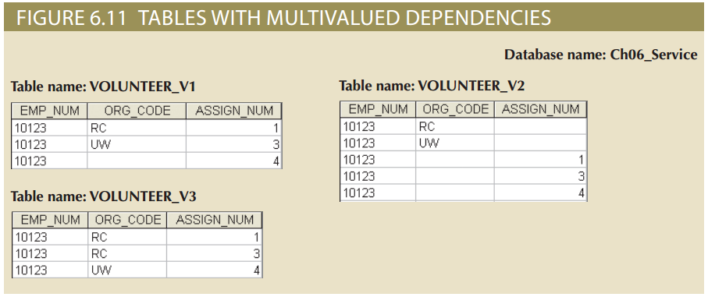
Fourth Normal Form (4NF) (2 of 2)

Slide 26
Normalization and Database Design (1 of 6)
Normalization should be part of the design process
Proposed entities must meet required the normal form before table structures are created
Principles and normalization procedures to be understood to redesign and modify databases
ERD is created through an iterative process
Normalization focuses on the characteristics of specific entities

Slide 27
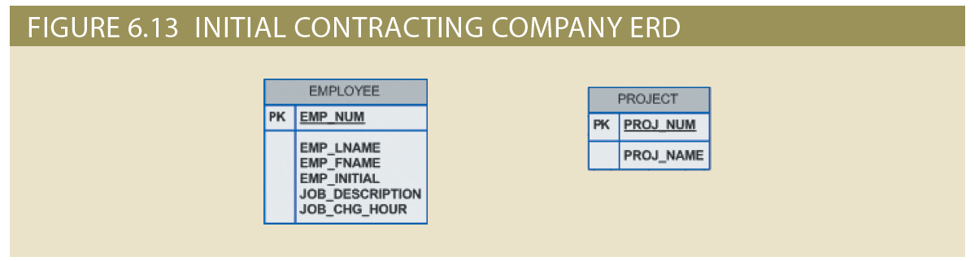
Normalization and Database Design (2 of 6)

Slide 28
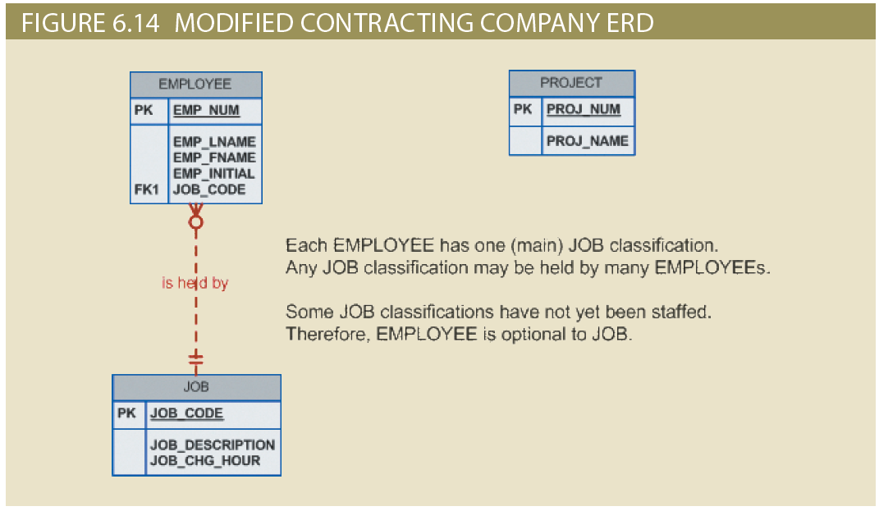
Normalization and Database Design (3 of 6)

Slide 29
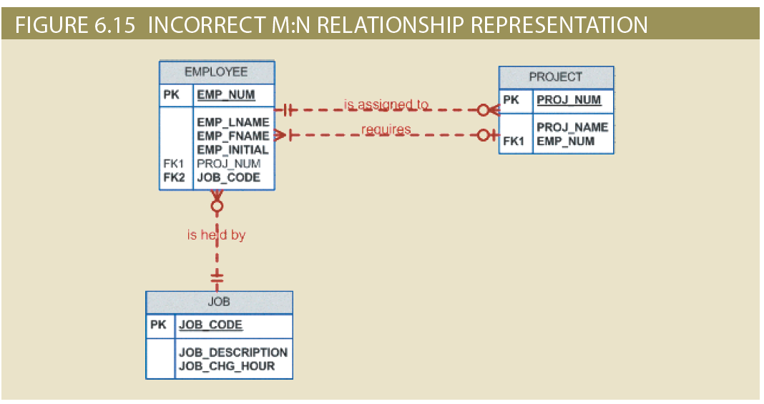
Normalization and Database Design (4 of 6)

Slide 30
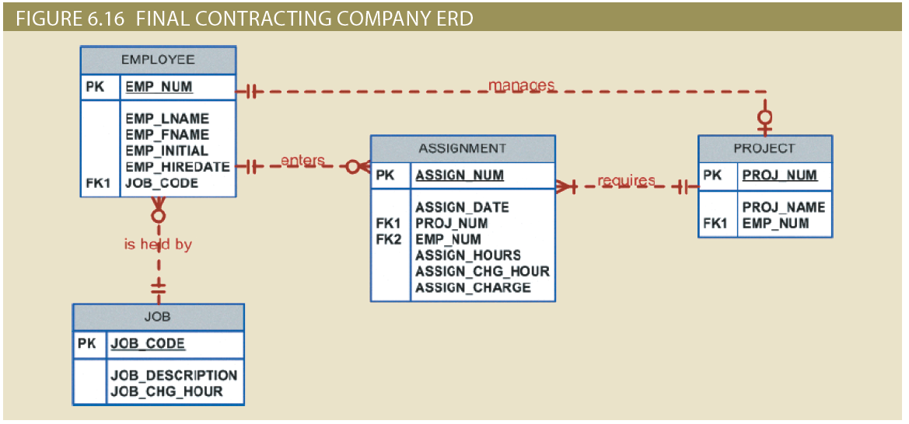
Normalization and Database Design (5 of 6)

Slide 31
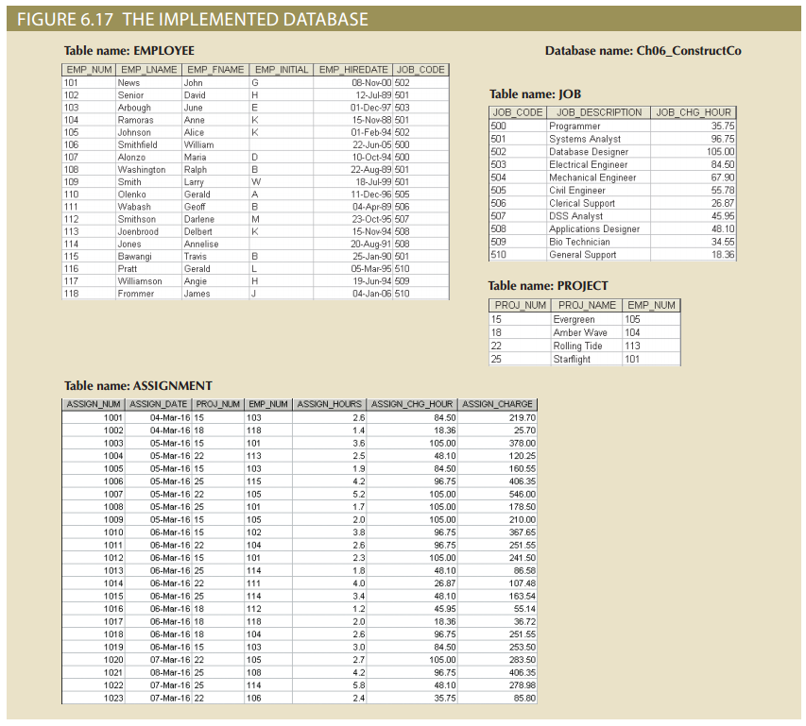
Normalization and Database Design (6 of 6)

Slide 32
Denormalization (1 of 2)
Design goals
Creation of normalized relations
Processing requirements and speed
Number of database tables expands
Tables are decomposed to conform to normalization requirements
Joining a larger number of tables
Takes additional input/output (I/O) operations and processing logic
Reduces system speed
Defects in unnormalized tables
Data updates are less efficient because tables are larger
Indexing is more cumbersome
No simple strategies for creating virtual tables known as views

Slide 33
Denormalization (2 of 2)
Table 6.6: Common Denormalization Examples
Case | Example | Rationale and Controls
Redundant data | Storing ZIP and CITY attributes in the AGENT table when ZIP determines CITY (see Figure 2.2) | Avoid extra join operations Program can validate city (drop-down box) based on the zip code
Derived data | Storing STU_HRS and STU_CLASS (student classification) when STU_HRS determines STU_CLASS (see Figure 3.28) | Avoid extra join operations Program can validate classification (lookup) based on the student hours
Preaggregated data (also derived data) | Storing the student grade point average (STU_GPA) aggregate value in the STUDENT table when this can be calculated from the ENROLL and COURSE tables (see Figure 3.28) | Avoid extra join operations Program computes the GPA every time a grade is entered or updated STU_GPA can be updated only via administrative routine
Information requirements | Using a temporary denormalized table to hold report data; this is required when creating a tabular report in which the columns represent data that are stored in the table as rows (see Figures 6.17 and 6.18) | Impossible to generate the data required by the report using plain SQL No need to maintain table Temporary table is deleted once report is done Processing speed is not an issue

Slide 34
Data-Modeling Checklist (1 of 6)
Business rules
Properly document and verify all business rules with the end users
Ensure that all business rules are written precisely, clearly, and simply
The business rules must help identify entities, attributes, relationships, and constraints
Identify the source of all business rules, and ensure that each business rule is justified, dated, and signed off by an approving authority

Slide 35
Data-Modeling Checklist (2 of 6)
Data modeling
Naming conventions: all names should be limited in length (database-dependent size)
Entity names:
Should be nouns that are familiar to business and should be short and meaningful
Should document abbreviations, synonyms, and aliases for each entity
Should be unique within the model
For composite entities, may include a combination of abbreviated names of the entities linked through the composite entity

Slide 36
Data-Modeling Checklist (3 of 6)
Attribute names:
Should be unique within the entity
Should use the entity abbreviation as a prefix
Should be descriptive of the characteristic
Should use suffixes such as _ID, _NUM, or _CODE for the PK attribute
Should not be a reserved word
Should not contain spaces or special characters such as @, !, or &
Relationship names:
Should be active or passive verbs that clearly indicate the nature of the relationship

Slide 37
Data-Modeling Checklist (4 of 6)
Entities:
Each entity should represent a single subject
Each entity should represent a set of distinguishable entity instances
All entities should be in 3NF or higher
Any entities below 3NF should be justified
Granularity of the entity instance should be clearly defined
PK should be clearly defined and support the selected data granularity

Slide 38
Data-Modeling Checklist (5 of 6)
Attributes:
Should be simple and single-valued (atomic data)
Should document default values, constraints, synonyms, and aliases
Derived attributes should be clearly identified and include source(s)
Should not be redundant unless this is required for transaction accuracy, performance, or maintaining a history
Nonkey attributes must be fully dependent on the PK attribute
Relationships:
Should clearly identify relationship participants
Should clearly define participation, connectivity, and document cardinality

Slide 39
Data-Modeling Checklist (6 of 6)
ER model:
Should be validated against expected processes: inserts, updates, and deletions
Should evaluate where, when, and how to maintain a history
Should not contain redundant relationships except as required (see attributes)
Should minimize data redundancy to ensure single-place updates
Should conform to the minimal data rule: All that is needed is there, and all that is there is needed

Slide 40
Summary (1 of 2)
Normalization is a technique used to design tables in which data redundancies are minimized
A table is in 1NF when all key attributes are defined and all remaining attributes are dependent on the primary key
A table is in 2NF when it is in 1NF and contains no partial dependencies
A table is in 3NF when it is in 2NF and contains no transitive dependencies
A table that is not in 3NF may be split into new tables until all of the tables meet the 3NF requirements
Normalization is an important part—but only a part—of the design process
A table in 3NF might contain multivalued dependencies that produce either numerous null values or redundant data

Slide 41
Summary (2 of 2)
The larger the number of tables, the more additional I/O operations and processing logic you need to join them
The data-modeling checklist provides a way for the designer to check that the ERD meets a set of minimum requirements

